Slide 1

Computer System Servicing

Slide 2
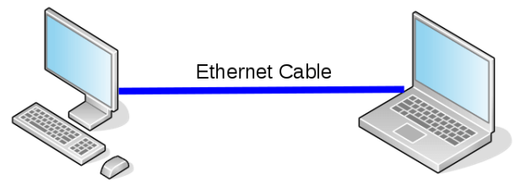
Motivation:

Slide 3
Network Configuration

Slide 4
Network Configuration
Change Computer Name and Workgroup
Change the IP Address
Turn OFF Windows Firewall
Turn ON Network Discovery

Slide 5
Network Configuration
Change Computer Name and Workgroup

Slide 6
Network Configuration
Change the IP Address

Slide 7
Network Configuration
Turn OFF Windows Firewall

Slide 8
Network Configuration
Turn ON Network Discovery

Slide 9
Practical Application of the acquired
Learning Competencies

Slide 10

GENERALIZATION

Slide 11
THANK YOU!!!

